Slide 1
CGB1221 – DATABASE MANAGEMENT SYSTEM
Department of Artificial Intelligence and Data Science
Academic Year: 2024 – 2025 (Even Semester)
Register Number : 2303811724321119
Name : Vaithyanadhan S G
Year : II Year
Semester : IV
Section : B
Date : 04-06-2025

Slide 2
Project Title
Cab Website for a Company

Slide 3
Problem Identification
Delays in Cab Allocation : Employees wait too long for cabs due to manual assignment.
Unclear Fare Calculation : No proper fare estimation, leading to overcharging and confusion.
Driver Management Issues : No proper system to assign and manage driver schedules.
Lack of Ride History : Companies cannot easily track past rides and expenses.

Slide 4
Objective
User Login & Management: Employees and admins can register, log in, and manage profiles.
Cab Booking: Users can book a cab, and the system assigns an available driver.
Fare Calculation: The system calculates the fare based on distance and time.
Driver Management: The system assigns and updates driver availability.
Ride History: Users and admins can view past bookings and payments.

Slide 5
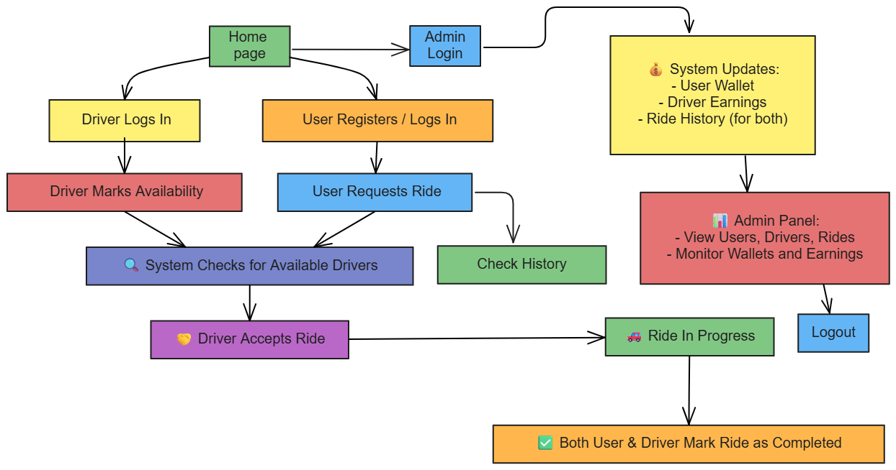
Proposed Architecture

Slide 6
List of Modules
User Modules:
User Registration & Login, User Dashboard, Wallet System
Driver Module:
Driver Login , Driver Dashboard, Ride Assignment, Driver Earning Tracker
Admin Module:
Login & Dashboard, Ride & Wallet Monitoring
History & Calculation Module:FFFFFFFFFFFFFFF
Ride History, Ride Booking and Cancellation with Refund, Calculates the Fair of User
F

Slide 7
List of Modules
Admin Module:
Login & Dashboard
Ride & Wallet Monitoring
History & Calculation Module:FFFFFFFFFFFFFFF
Ride History
Ride Booking and Cancellation with Refund
Calculates the Fair of User
FF

Slide 8
Module Description
User Module
User Registration & Login: Enables new users to register and securely log in with authentication.
User Dashboard: Central hub to book rides, view history, and track ride status.
Ride Booking: Allows users to select pickup and destination, and book a ride.
Ride Cancellation & Refund: Lets users cancel rides and receive full or 50% refund based on driver assignment.
Wallet System: Manages user fare deduction and refunds through wallet balance updates.

Slide 9
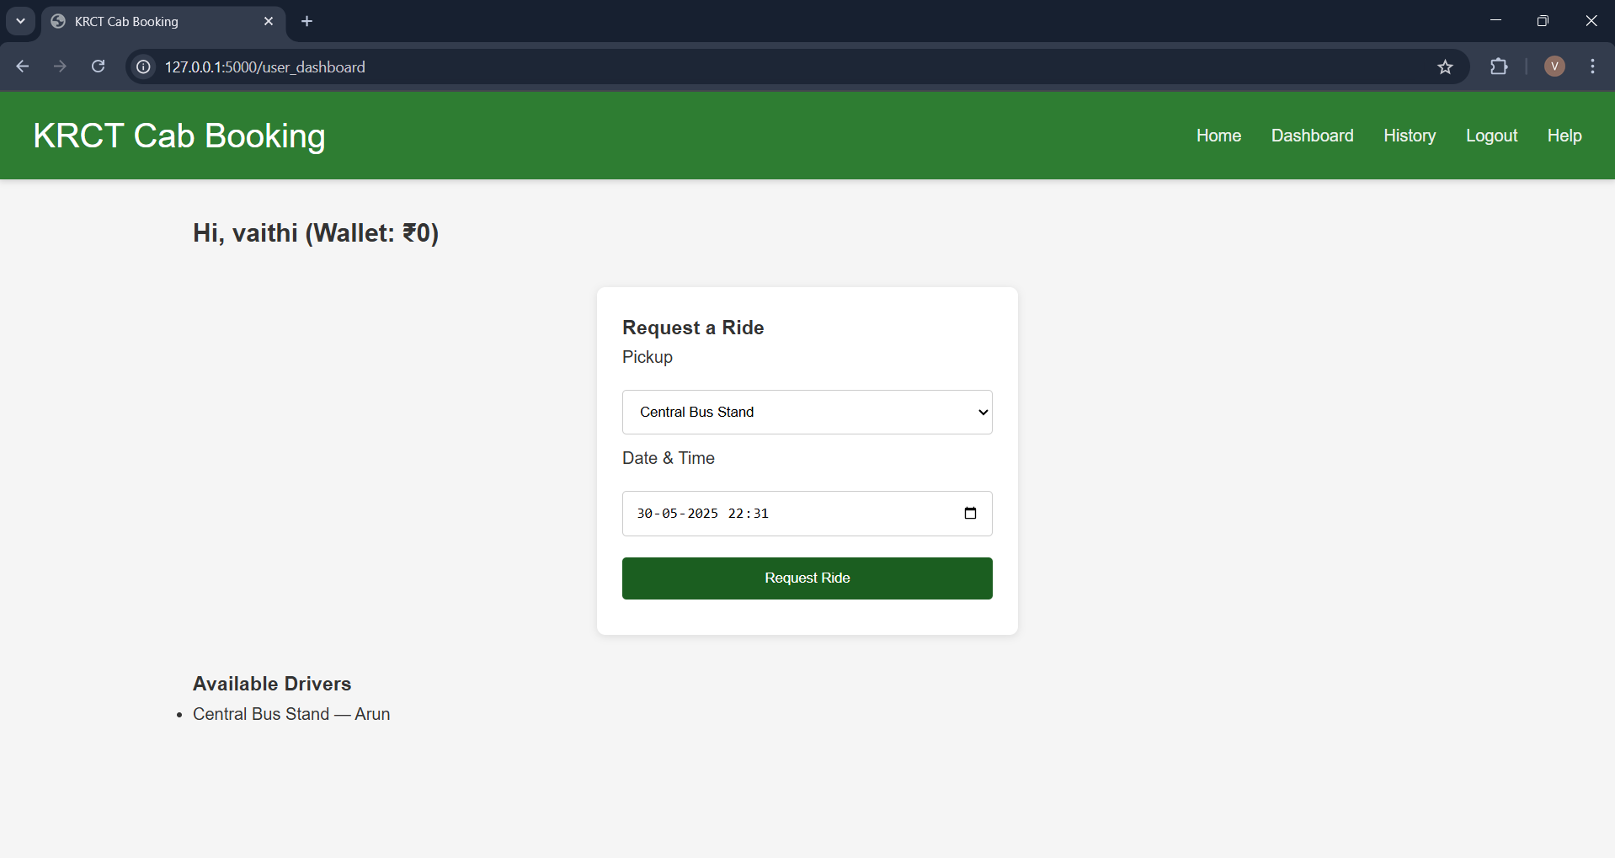
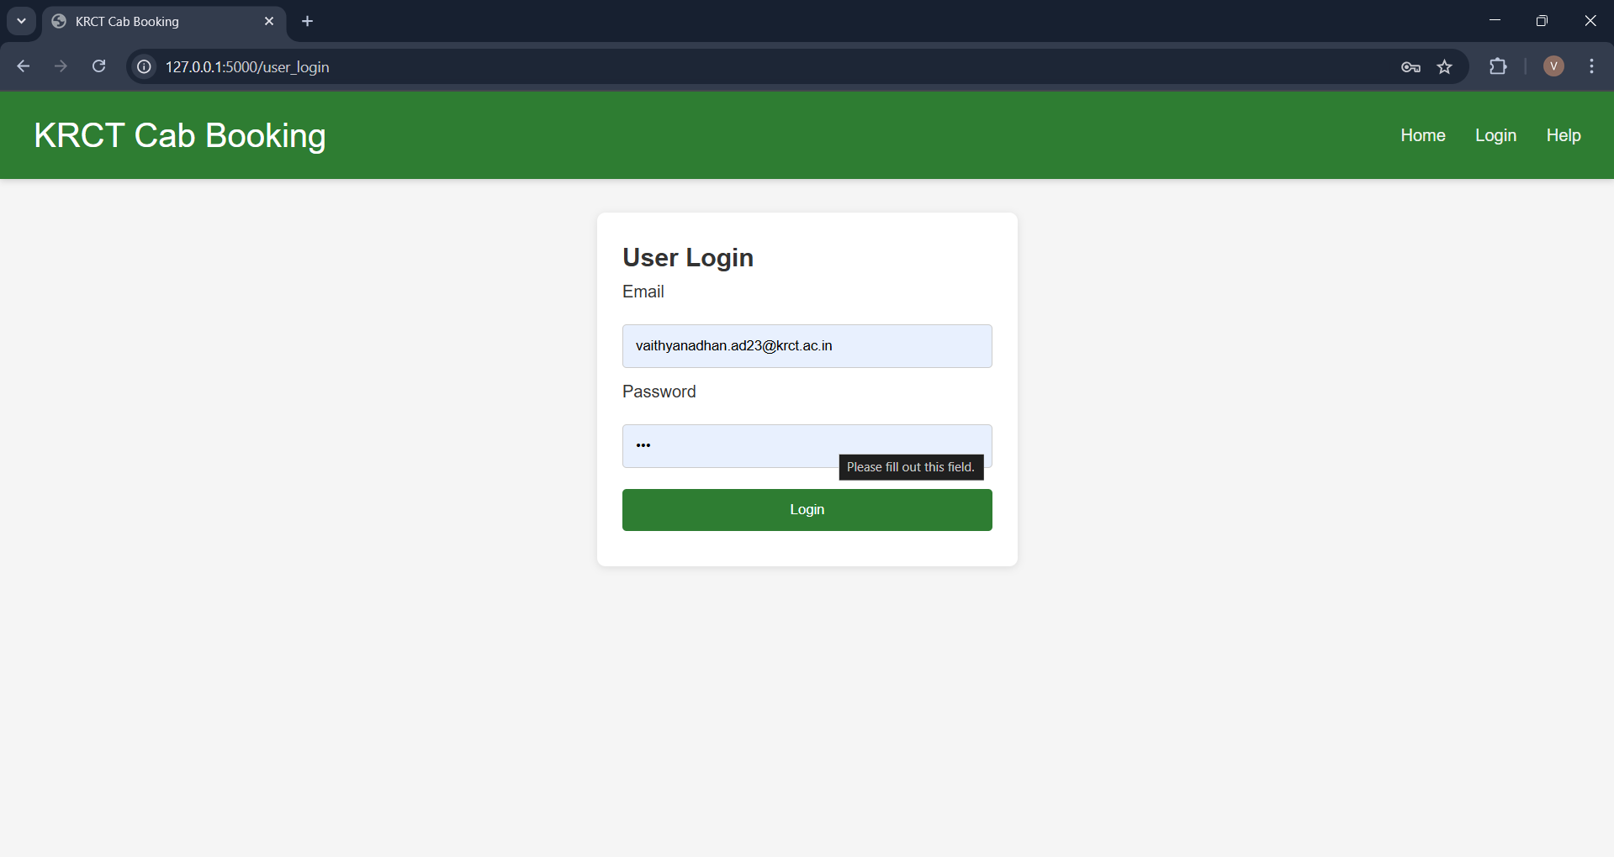
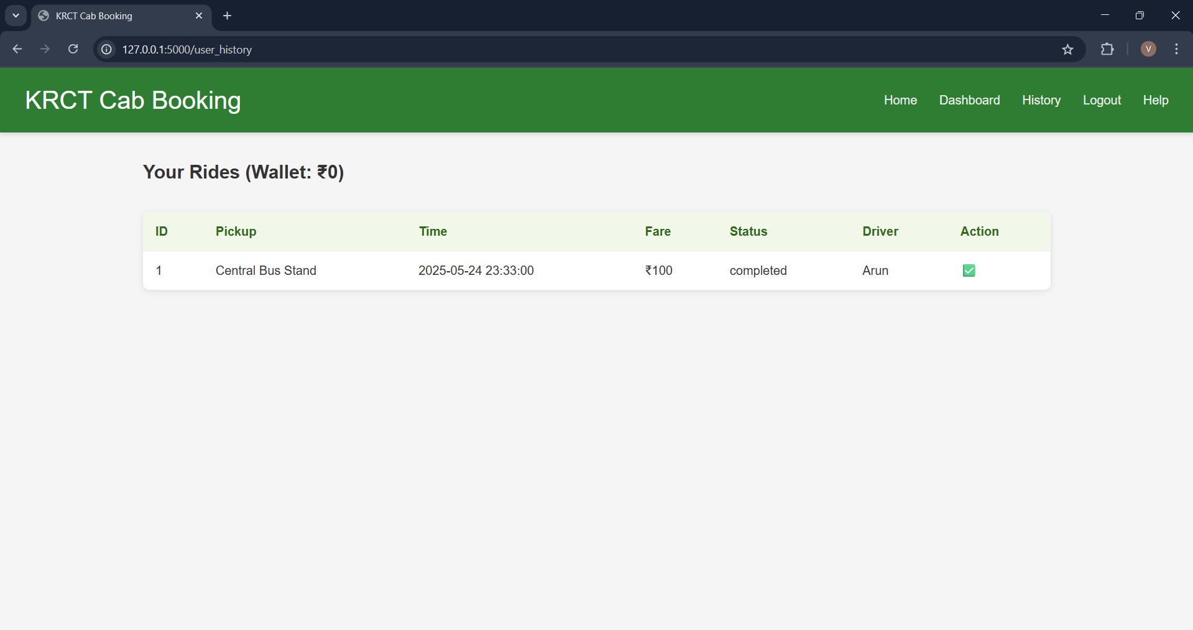
Results
User Login:

Slide 10
Module Description
Admin Module
Admin Login & Dashboard: Pprovides centralized access to monitor users, drivers, and rides.
Ride & Wallet Monitoring: Allows admin to track ride statuses, payments, and refunds.

Slide 11
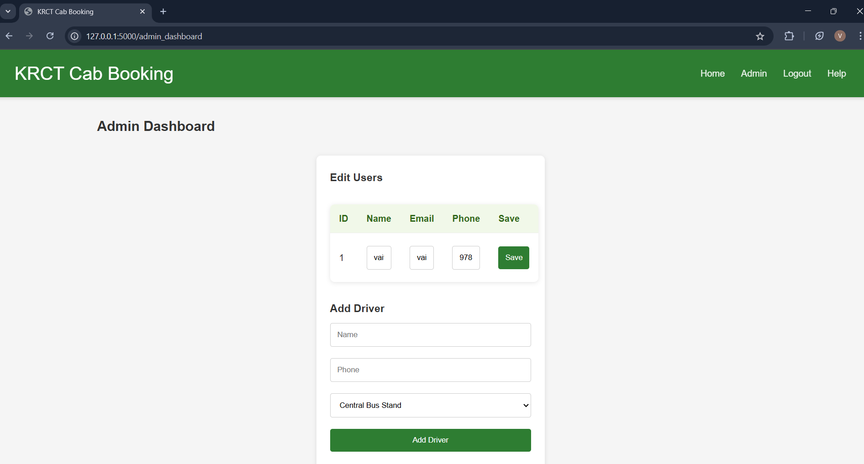
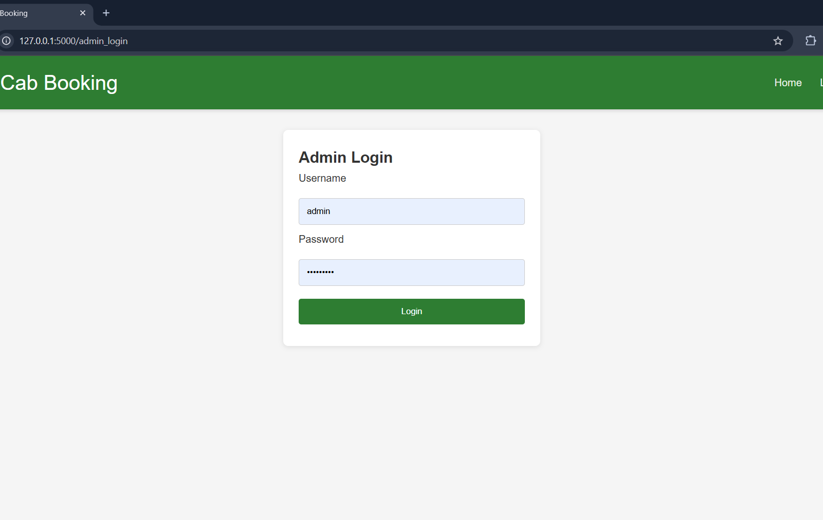
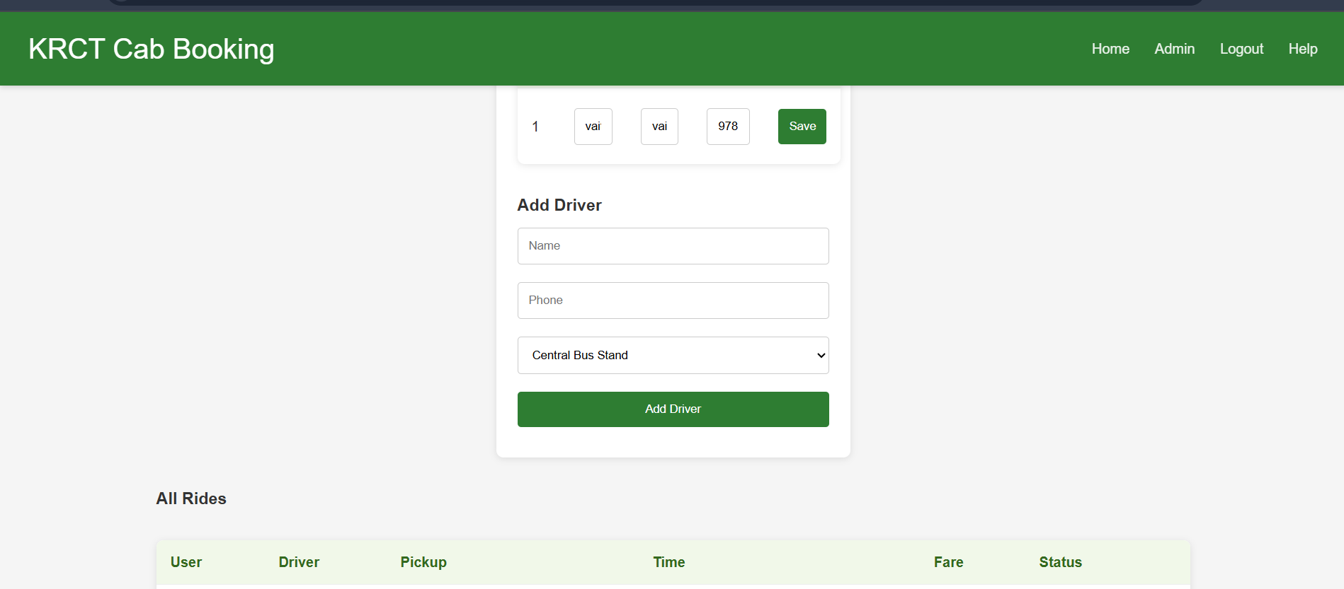
Results
Admin Login:

Slide 12
Module Description
Driver Modules:
Driver Login: Authenticates driver access using predefined database credentials.
Driver Dashboard: Shows available ride requests and allows drivers to manage rides.
Ride Assignment: Enables drivers to accept rides manually and prevents double booking.
Driver Earnings Tracker: Tracks and displays driver income from completed or cancelled rides.

Slide 13
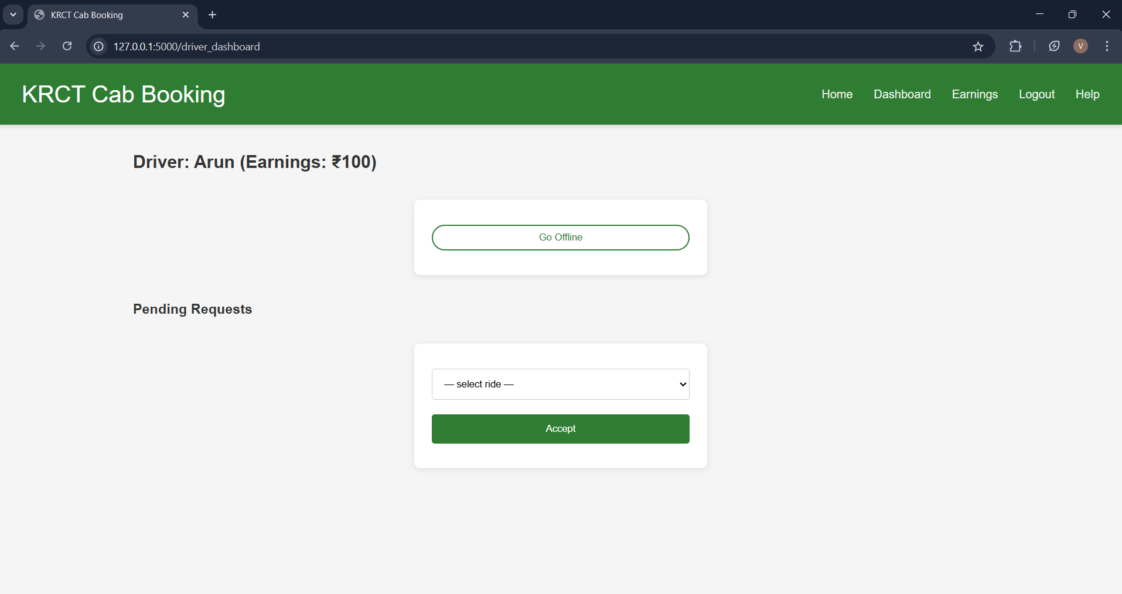
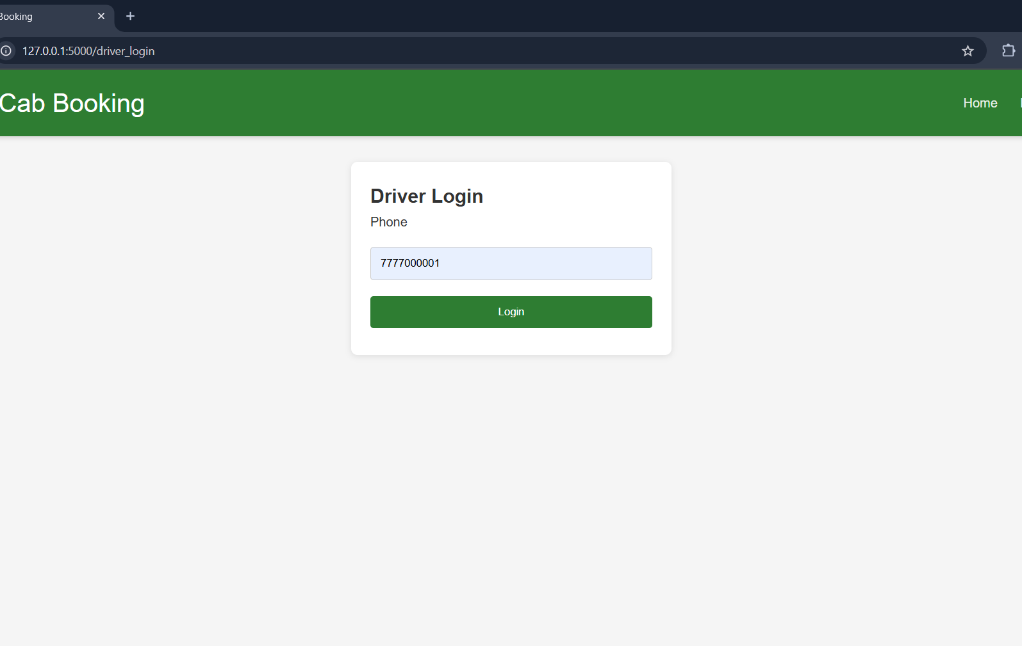
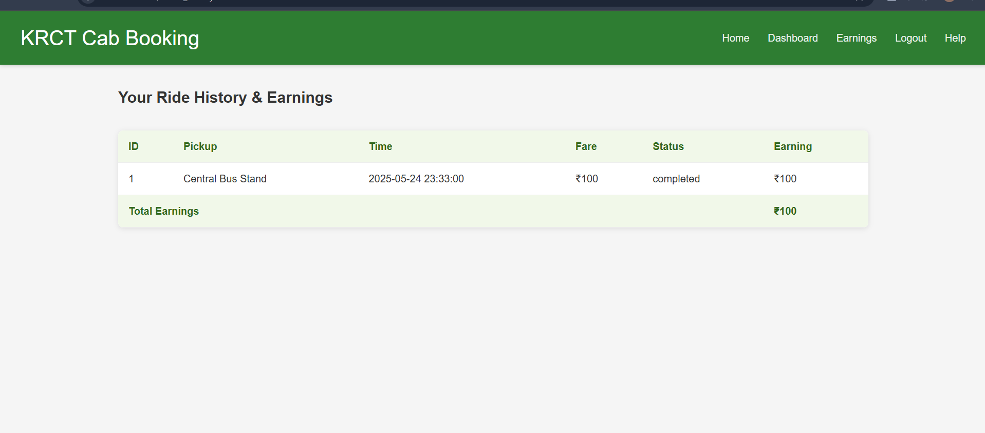
Results
Driver Login:

Slide 14
Module Description
History & Calculation Modules:
To track ride: completed/canceled rides, user refund eligibility, and driver earnings.
User Ride History: Shows list of past rides with fare and refund status.
Driver Ride History: Lists all accepted rides, status, and earnings.
Refund Logic: Applies full or 50% refund based on driver assignment.
Earnings Table: Displays per-driver summary with total amount earned.

Slide 15
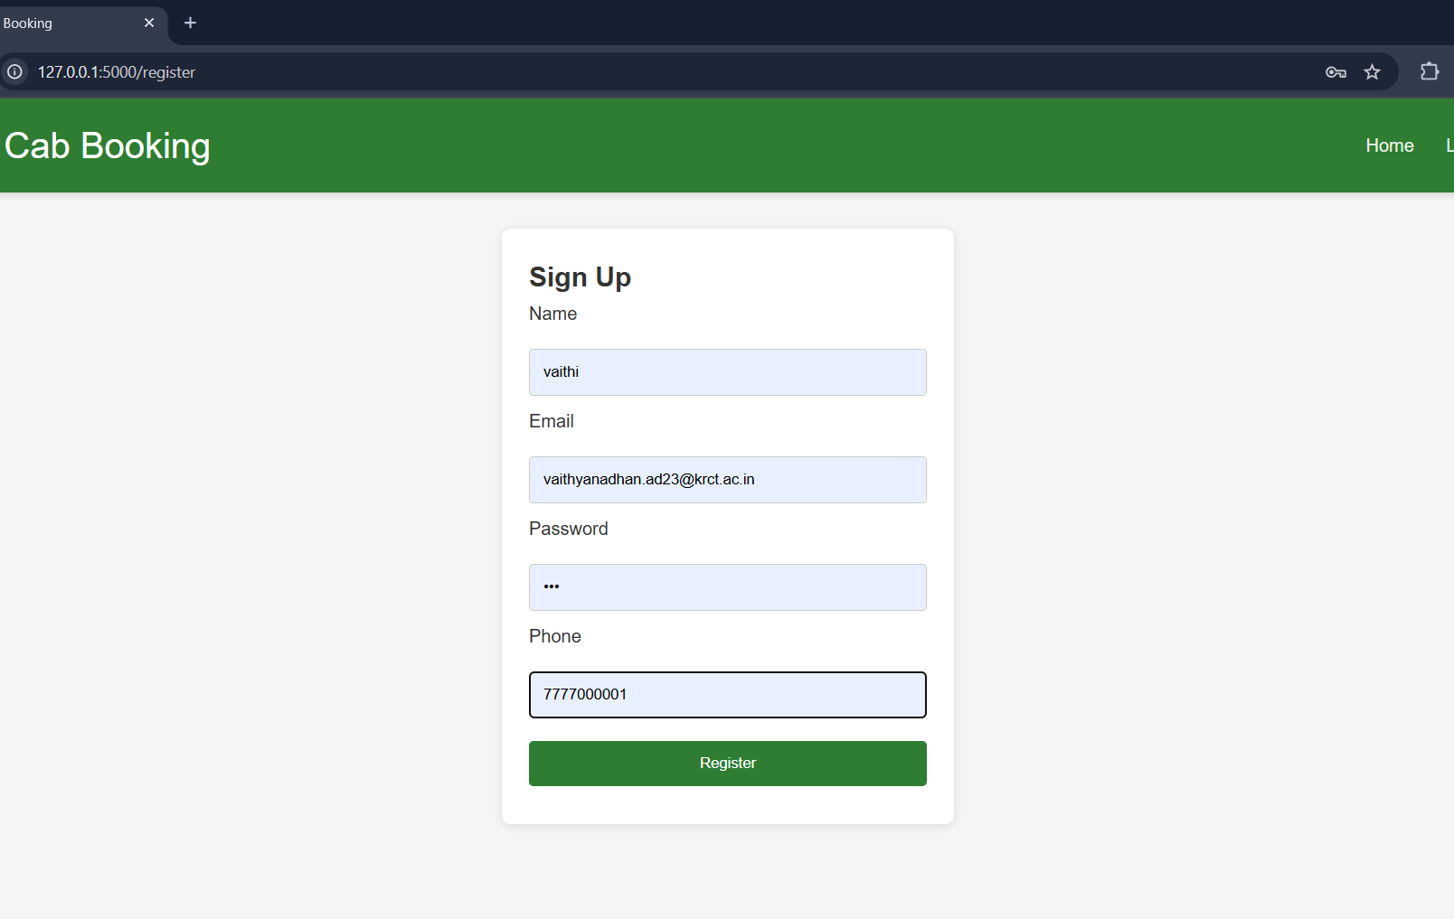
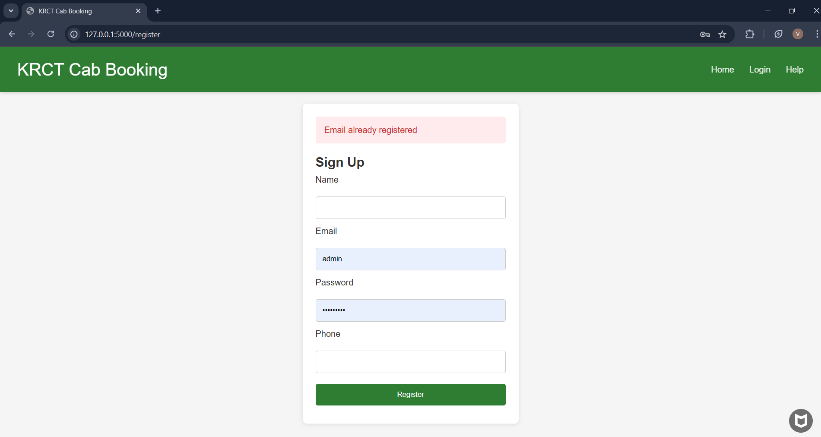
Results
Register New User:

Slide 16
Conclusion
The Cab Booking System successfully delivers a reliable, end-to-end solution for managing employee transportation. By combining a clean Flask‑based backend with a responsive HTML/CSS/JavaScript frontend and a robust MySQL database, the platform automates ride booking, driver assignment, real-time tracking, payment handling, and cancellations with flexible refund policies. Users benefit from an intuitive dashboard, wallet management, and clear ride history, while drivers can efficiently accept requests, complete rides, and monitor their earnings. The system’s modular design and secure data handling ensure smooth operation and easy future enhancements-such as live map integration, SMS notifications, or expanded reporting-making it a scalable and user‑friendly tool for any organization’s cab service needs.

Slide 17
Thank You
ANY QUERIES???

